Slide 1
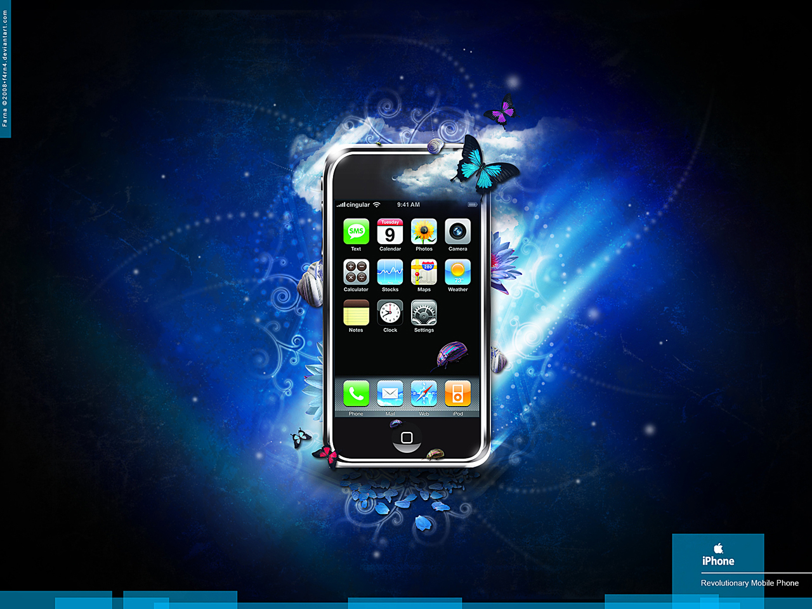
Presentation on
3G Mobiles
3G Mobiles

Slide 2
Presented to:
Presented by:

Slide 3
PRESENTED BY AND DESIGNED
Presentation Point check out link below for more presentations (www.presentationpoint.yolasite.com)
IDEA BY:
FUTURE IT (www.futureit.yolasite.com)
SUPPORTED BY:
www.exploretomorrow.blogspot.com

Slide 4
Structure of presentation
What is 3G?
Comparison between 1G-2G and 3G
Evolution towards 3G mobile
3G standard and capabilities
3G Applications
3G performance
3G mobile place in market
Example of 3G mobile
Summary

Slide 5
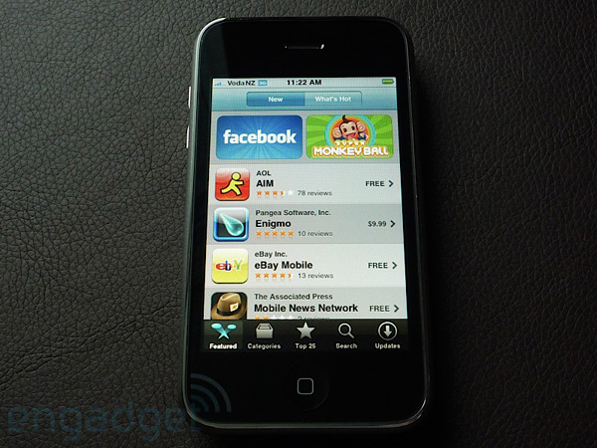
What is 3G mobile?
3G is the third Generation of mobile phone standards based on the International Telecommunication Union (ITU) family of standards "IMT-2000".

Slide 6
IMT-2000 (3G): The mobile internet
IMT-2000 is simply a term used by the International Telecommunications Union (ITU) to refer to third generation (3G) wireless technology, that provide higher data speed between mobile phones.
IMT-2000 the third generation mobile standard enables mobile users to harness full power of the internet through efficient high-speed radio transmission, optimized for multimedia communications.

Slide 7
Comparison between 1G-2G-3G
3G
Digital
Voice
Data: 384kbps
Anytime, anywhere connectivity
IP based
2G
Digital
Voice
Data: 14.4kbps
1G
Analog
Voice only
1987 1993 2003

Slide 8
Evolution towards 3G 3G is the fastest, 2G is fast, and 1G no longer exists.

Slide 9
3G capabilities
High speed data transmission
Improved voice quality
Greater capacity
Multiple simultaneous service
Global roaming across networks
Improved security
Service flexibility
Symmetrical and asymmetrical data transmission support

Slide 10
3G Applications
Wireless internet
Audio on demand
Electronic postcards
Video conferencing
Secure mobile commerce transactions
Traffic and traveling information-location specific

Slide 12
3G performance advantage time to download a 1MB of file:
Fixed line modem:
GSM cell phone:
Enhanced GSM phone:
3G phone (outdoor):
3G phone (indoor):
3 minutes
15 minutes
1-5 minutes
21 seconds
4 seconds

Slide 14
Market trend towards 3G
Mobile and internet penetration both growing rapidly.
3G Mobile penetration have changed the trend of using desktop computer even laptops.
People are feeling more reliable using 3G mobile.
Market survey shows that due to high prices of 3G mobile technology, it is not in reach of every person.

Slide 15
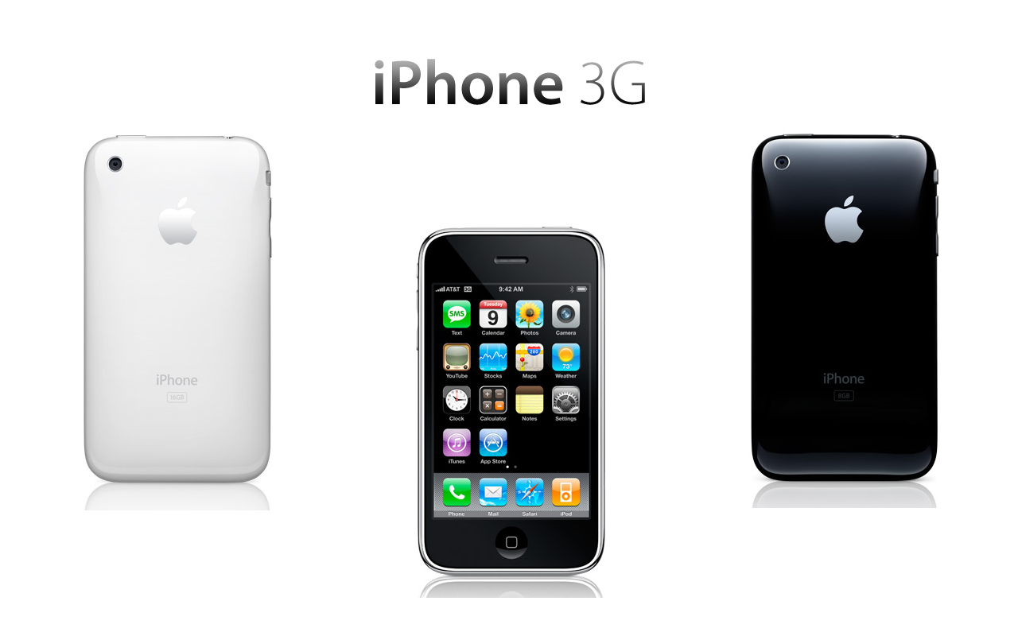
Example of 3G mobile

Slide 16
Summary
3G mobile is a major opportunity for business, commerce and consumers.
Brings together the two fastest growing market sectors- Mobile and Internet
Market services and standards evolving from 2G to 3G.
Significant opportunities for value added content and service providers.

Slide 17
Thank you

